Slide 1


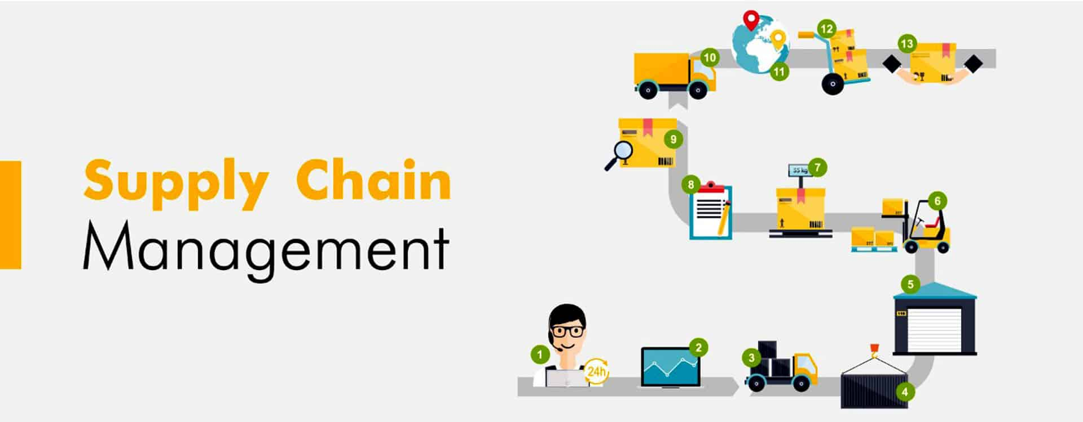
EVALUTING REQUIRED SAFETY INVENTORY: GIVEN A REPLENISHMENT POLICY
KEERTHANA S
205229116
II MSc Data Science

Slide 2
THE ROLE OF SAFETY INVENTORY IN A SUPPLY CHAIN
Forecasts are rarely completely accurate
If you keep only enough inventory in stock to satisfy average demand, half the time you would run out
The purpose of safety stock
The purpose of safety stock is to make sure your customer service levels stay high and your supply chain runs smoothly. With safety stock in place, your workers are not running around trying to constantly locate and reorder parts – they're fulfilling orders to your customers

Slide 3
How does it works
Safety stock is an additional quantity of an item held in the inventory to reduce the risk that the item will be out of stock.
It acts as a buffer stock in case sales are greater than planned and/or the supplier is unable to deliver the additional units at the expected time

Slide 4
Example
If average demand is 1000 units per week, then half the time actual demand will be greater than 1000, and half the time actual demand will be less than 1000; what happens when actual demand is greater than 1000?

Slide 5
Replenishment Policies
Decisions regarding when to reorder and how much to reorder.
Continuous review
Periodic review

Slide 6
Evaluating Safety Inventory
Assume that weekly demand for phones at B&M Office Supplies is normally distributed, with a mean of 2,500 and a standard deviation of 500. The manufacturer takes two weeks to fill an order placed by the B&M manager. The store manager currently orders 10,000 phones when the inven­tory on hand drops to 6,000. Evaluate the safety inventory and the average inventory carried by B&M. Also evaluate the average time a phone spends at B&M.

Slide 7
Evaluating Safety Inventory Given a Replenishment
Policy Expected demand during lead time = DL
Standard deviation of weekly semand D=500
Safety inventory, ss = ROP – DL
Reorder point, ROP = 6,000
Evaluating Cycle Service Level and Fill Rate Average demand per week, D = 2,500
Average lead time for replenishment, L = 2 weeks
Safety Inventory ss = ROP – DL = 6,000 – 5,000 = 1,000
Average lot size, Q = 10,000
Cycle inventory = Q/2 = 10,000/2 = 5,000
Average Inventory = Cycle inventory+Safety inventory
5000+1000=6000
Average flow time = average inventory/throughput = 6,000/2,500 = 2.4 weeks

Slide 8


